Slide 1
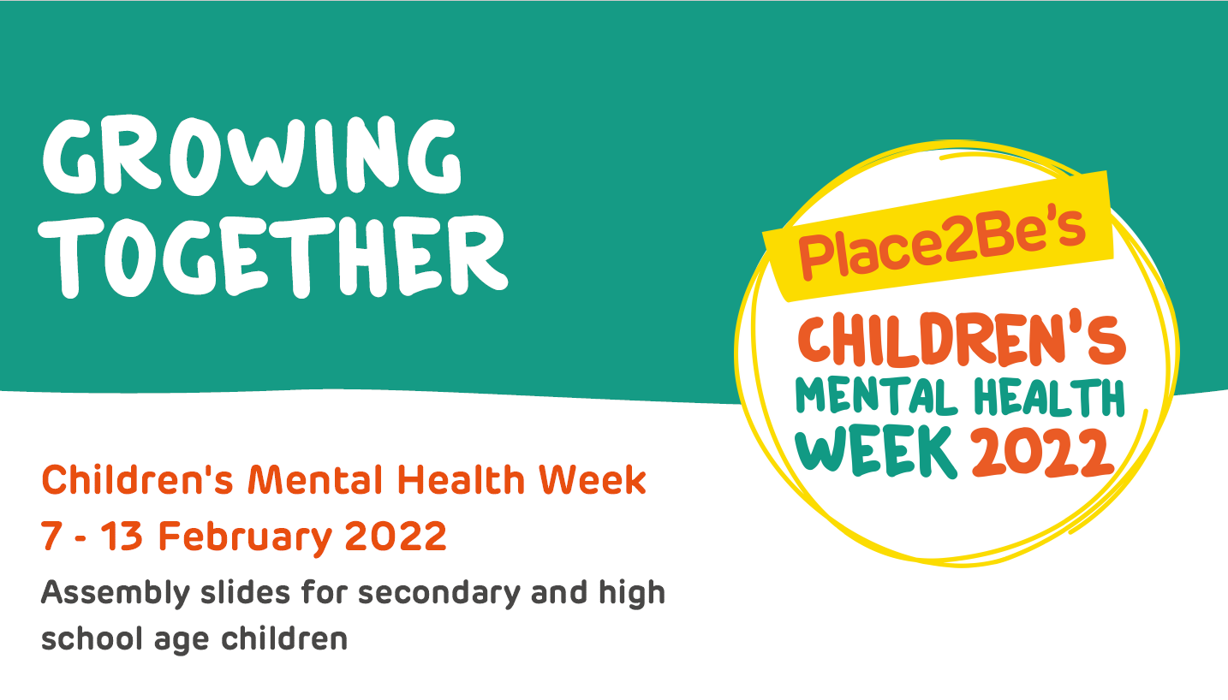

Slide 3
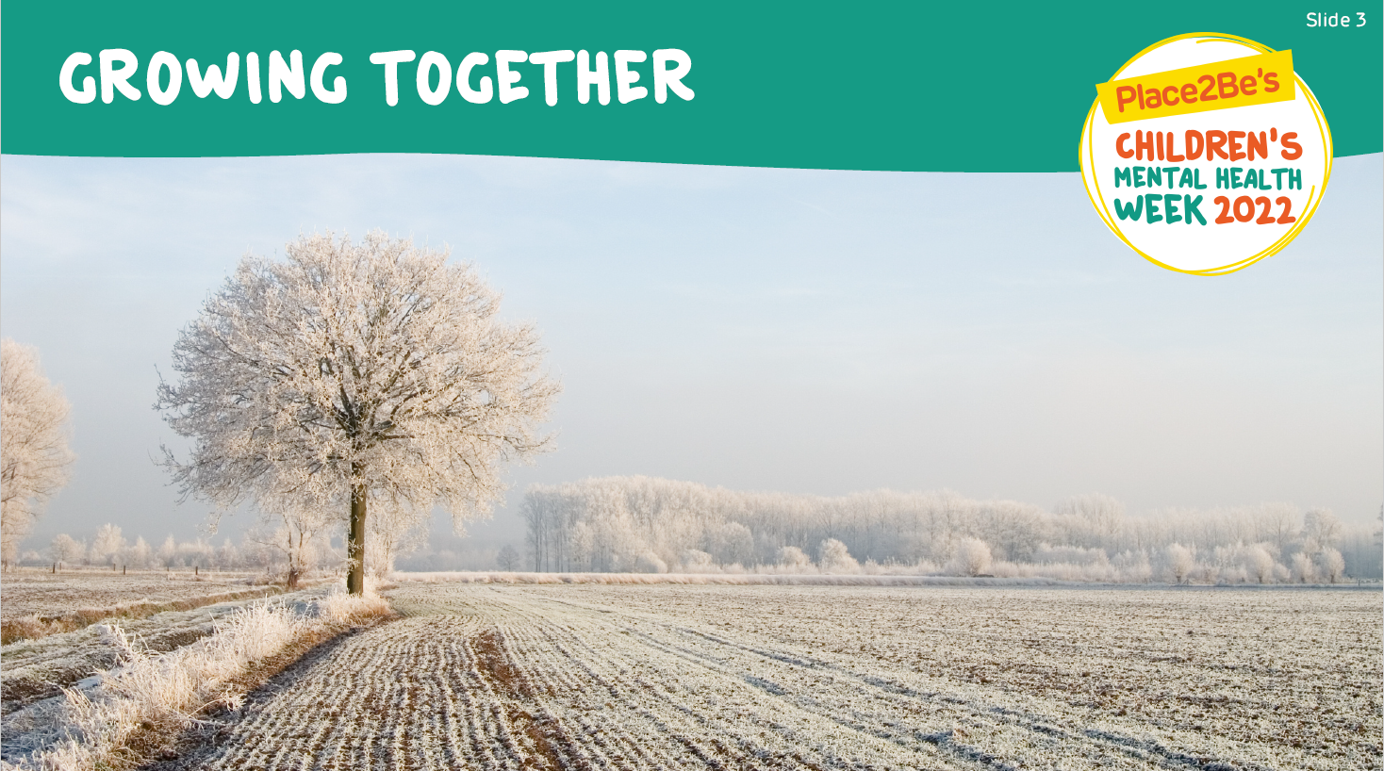
Dr Alex George's Growth Story teaser | Children's Mental Health Week 2022 - YouTube

Slide 6
Other growth videos are available on the Children's Mental Health Week website, there will also be a link to this website all week on class charts
Children's Mental Health Week (childrensmentalhealthweek.org.uk)

